Slide 1
Online Homemade Cake Booking
22pmc144 REVATHY S

Slide 2
Abstract
Deva's Online Homemade Cake Booking website is a user-friendly platform allowing users to register, browse through various homemade cakes, and place orders conveniently. Users can explore cake details, leave reviews, and rate cakes based on their experiences. The website offers categorization for easy cake selection and provides a secure payment system for hassle-free transactions. With features like a shopping cart, order tracking, and enticing cake images, Deva's website aims to provide customers with a seamless and delightful cake-booking experience.

Slide 3
Requirements
1. User Registration 2. Cake Details 3. Feedback 4. Cake Type 5. Cart Management 6. Orders 7. Cake Payment

Slide 4
Features and Highlights 1. User Registration: Users can create an account by providing their personal information and credentials. User authentication and password hashing ensure secure registration. 2. Cake Catalog: The project allows for the creation and management of a catalog of cakes. Each cake entry includes details such as name, description, quantity, price, picture, and type. Cakes can be categorized by flavor, type, and occasion. 3. Customer Reviews : Users can leave reviews for cakes they have purchased or tried. Reviews include a description and associated cake.

Slide 5
4. Order Placement and Tracking: Customers can place orders based on the items in their shopping cart. Orders include details such as the customer, total amount, order status, address, and mobile number. Orders can have different statuses, such as "order processing," "order on the way," "order completed," etc. Customers can track the status of their orders. 5. Secure Payment Integration: The project includes a payment system where customers can securely make payments for their orders. Payment details, such as user ID, cake type, amount, card number, CVV, and status, are stored. 6. Cake Image Gallery: An image gallery allows users to view images of cakes along with descriptions. Images are uploaded and associated with cake entries.

Slide 6
Technical aspects Django: Django is a high-level Python web framework that follows the Model-View-Controller (MVC) architectural pattern. It provides a robust set of tools and features for building web applications efficiently. Python: Django is based on the Python programming language, which is known for its simplicity and readability. Python offers a wide range of libraries and frameworks that can be integrated with Django for various functionalities. Static and Media Files: Static files (CSS, JavaScript, images, etc.) are typically served by Django during development or through a separate web server in production. Media files (user uploads, images, etc.) are usually stored and served separately using a dedicated storage backend. Jazzmin: Jazzmin is a third-party Django package that provides an enhanced and customizable administration interface (admin panel) for Django projects. Skype : skype is used for payment.

Slide 7
CLASS DIAGRAM

Slide 8
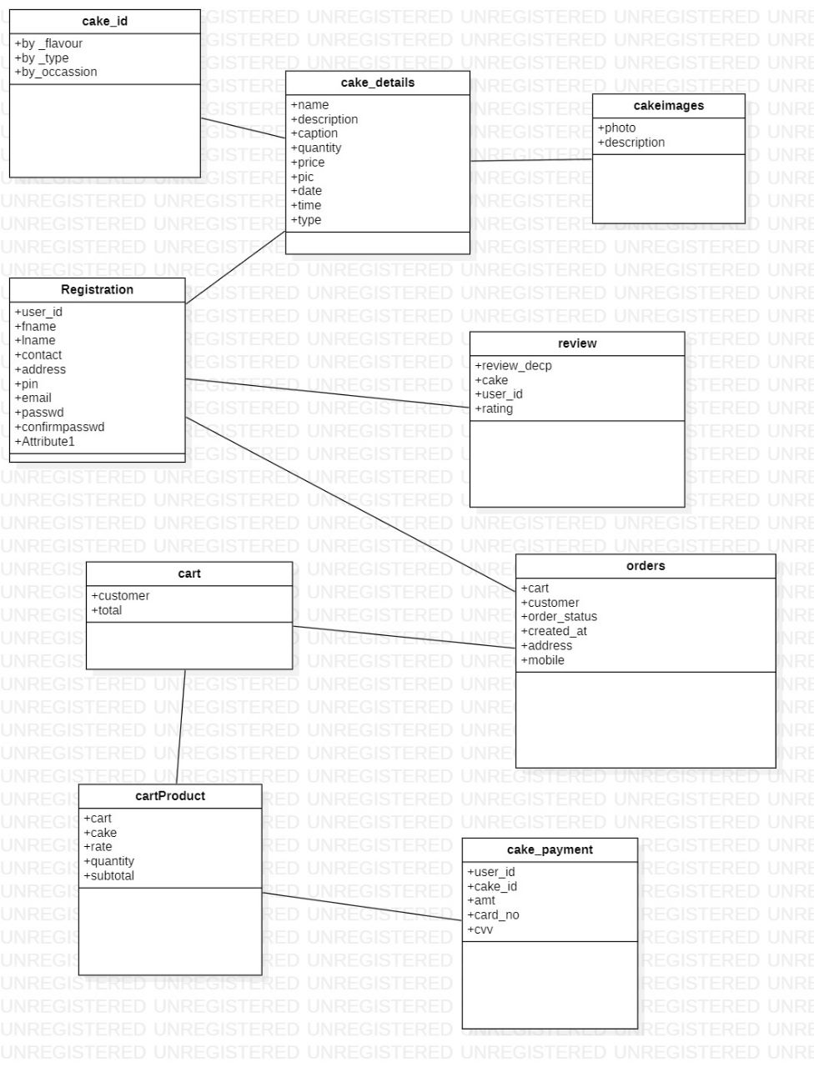

Slide 9
Challenges faced during the development
Technical knowledge gap
Time Management
Dealing with Codes and Errors
Intergrating third-party libraries
Scalability
Learning curve

Slide 10
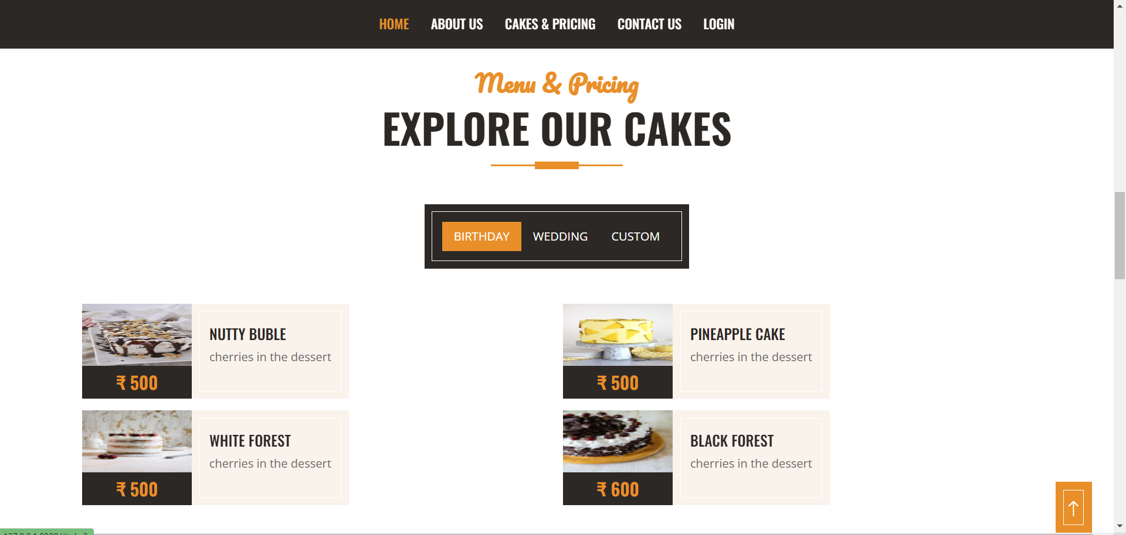
Screenshots
Users can easily identify the variety of cakes by searching

Slide 11
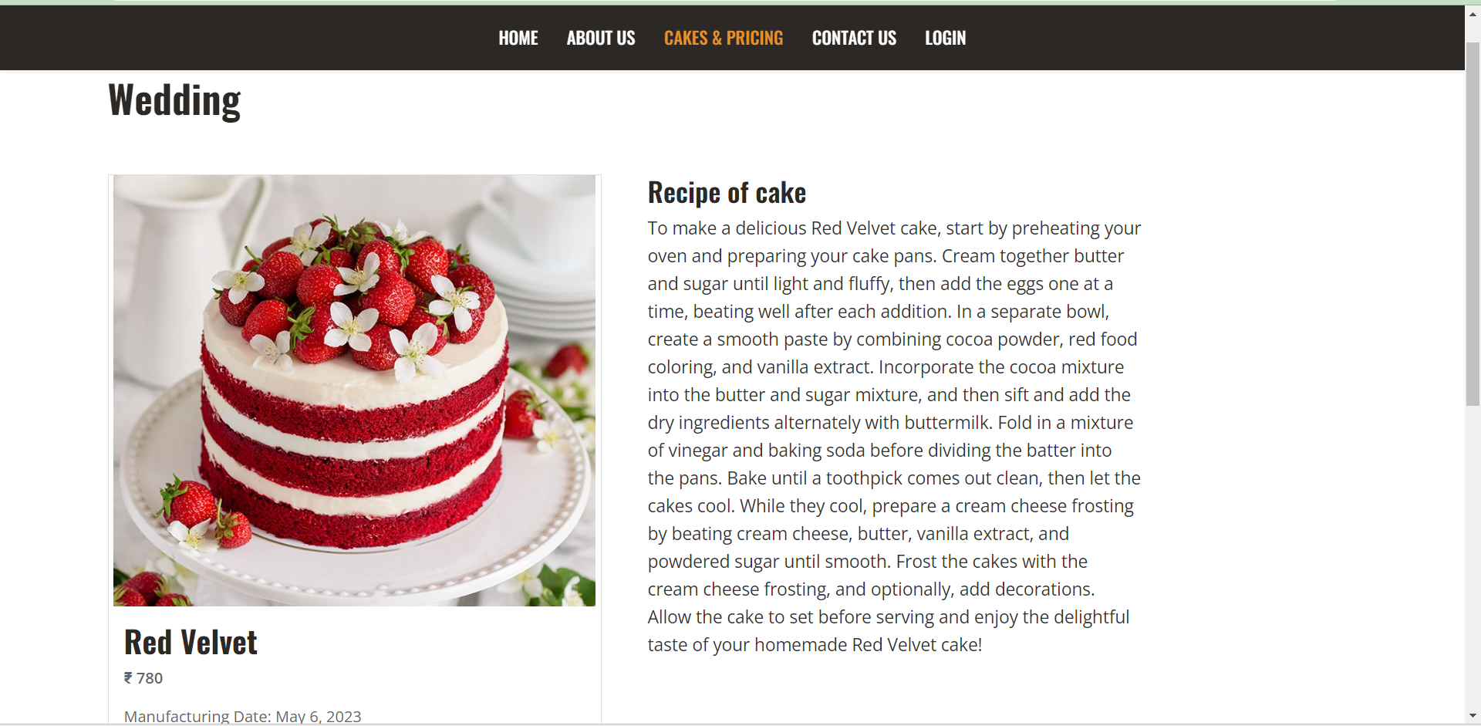
Screenshorts
Users can read the recipe for the cake

Slide 12
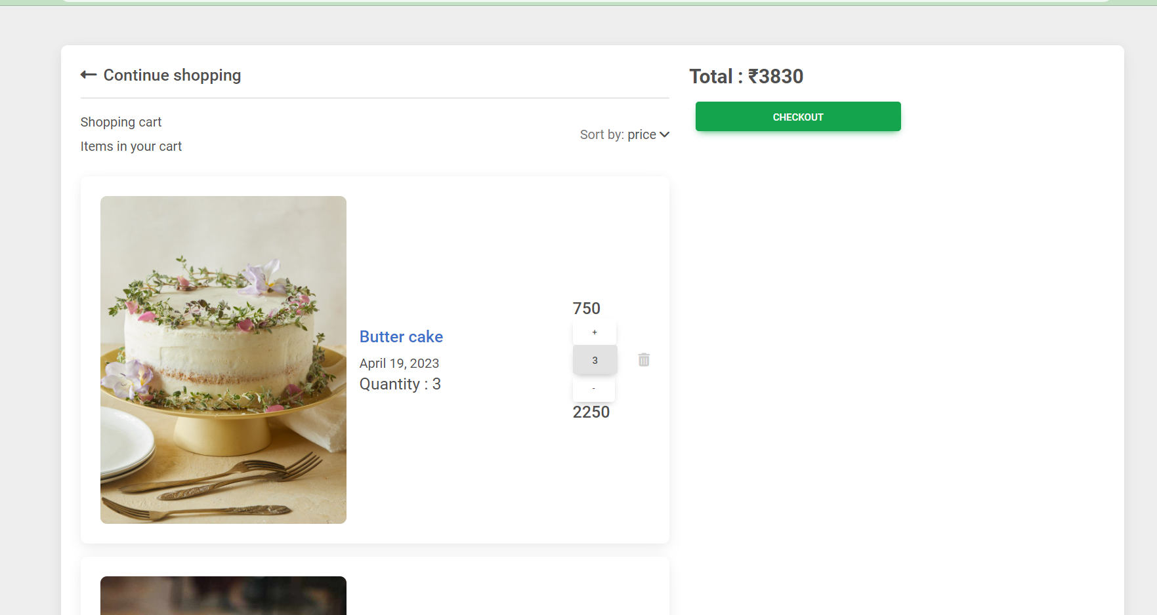
Screenshots
Users can add and delete products easily

Slide 13
Future Enhancements 1. Improved User Experience: Enhance the user interface and experience by adding interactive features such as search functionality, filters, sorting options, and pagination. Implement client-side validation to provide instant feedback to users when filling out forms 2. Order Tracking: Allow users to track the status of their orders in real time. Provide updates on order processing, shipping, and delivery through email notifications or a dedicated order tracking page. 3. Payment Integration: Integrate a secure payment gateway to enable users to make online payments for their orders. Implement features like order confirmation emails, invoice generation, and handling payment-related errors. 4. Image Gallery: Create an image gallery feature where users can view images of cakes, filter them by type or occasion, and view detailed descriptions. Add options for users to upload their cake images and share their creations. 5. Improved User Experience: Enhance the user interface and experience by adding interactive features such as search functionality, filters, sorting options, and pagination. Implement client-side validation to provide instant feedback to users when filling out forms.

Slide 14
Conclusion The Devas an online homemade cake booking system has transformed the home baking industry. This innovative system simplifies the cake ordering process, allowing customers to browse and select their desired cakes online. It brings efficiency and organization to bakers' businesses, enabling them to manage orders, track inventory, and schedule deliveries. Moreover, it expands the market reach for home bakers, attracting customers from different regions. The system fosters transparency and trusts through customer reviews and ratings. Overall, the online booking system has revolutionized homemade cake ordering, making it more convenient, efficient, and accessible for customers and bakers alike.

Slide 15
References 1. https://www.floweraura.com/cake-delivery/trivandrum 2. https://youtu.be/qdNhWIlTZ0c

